Slide 1
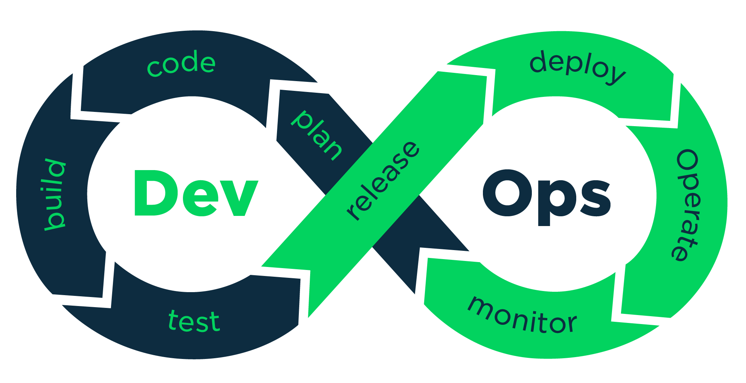
Continuous Deployment & Monitoring

Slide 2
DevOps Life Cycle Phases
Continuous Development
Continuous Testing
Continuous Integration
Continuous Deployment
Continuous Monitoring

Slide 3
Continuous Deployment
Configuration Management
Containerization

Slide 4
Configuration Management
Establish & Maintain Application’s functional requirements and Performance.
Releasing deployments to Servers.
Scheduling Updates on all Servers.
Maintain Configuration Consistency on All Servers.

Slide 5
Containerization
Containerization tool is a set of Tools which will maintain the consistency across the environments.
Docker is the First Containerization Tool.
Scheduling Updates on all Servers.
Maintain Configuration Consistency on All Servers.

Slide 6
Continuous Monitoring
Continuous Monitoring is monitor the System Performance.
Monitor the Product overall Performance.

Slide 7


